Slide 1
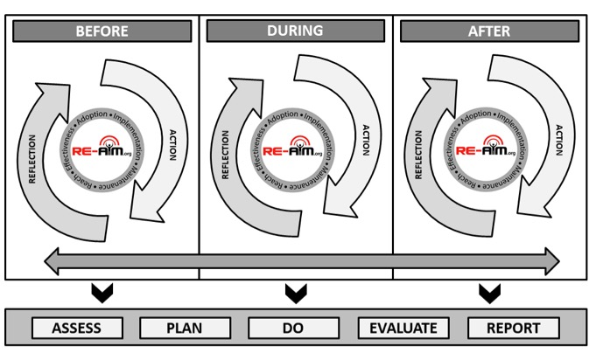
Conclusion

Slide 2
Thank you! Q&A

